Slide 1
Computational Biology 2

Slide 2
Team Members:
1-Ahmed Yahia
2-Yousef Barty
3-Yousef Shaban
4-Mario Ehab
5-Fares Ahmed
6-Mahmoud Taha

Slide 3
Task1:Metabolic Pathways
Pathways:
1-Glycolysis
2- PP
3-TCA
4-Fermentation(Acetate)
5- Oxidative Phosphorylation
6-Glutamine

Slide 4
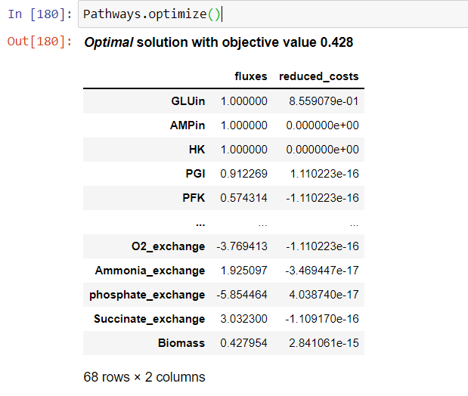
Objective Value

Slide 5
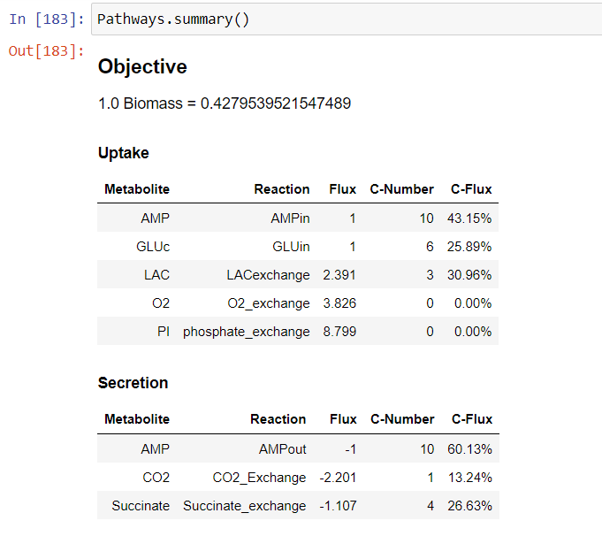
Model Summary

Slide 6
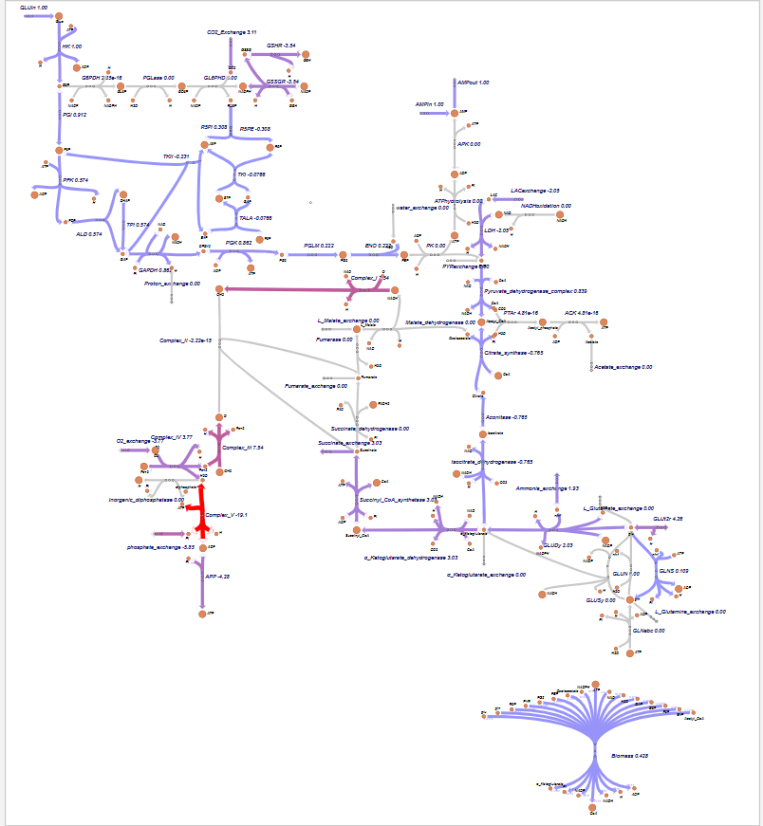
Pathways using Escher

Slide 7
Task 2: Networkx Project
Organisms:
1-Human
2-E-coli
3-Yeast
Filenames:
1- HomoSapiens_lcc_hq.txt
2-EscherichiaColiK12_cocomp_hq.txt
3-DrosophilaMelanogaster_lcc_hq.txt

Slide 8
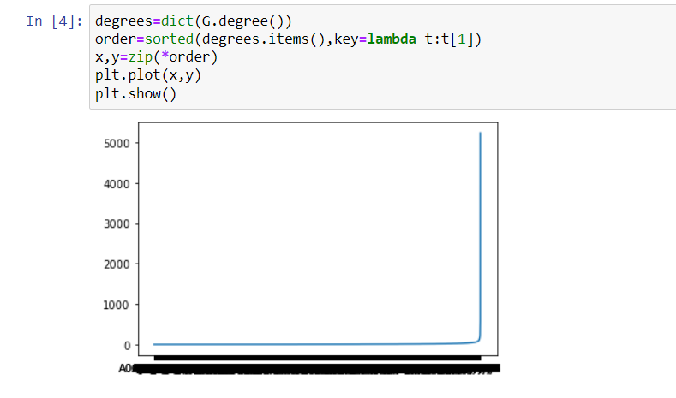
First File(Human): HomoSapiens_lcc_hq.txt
Visualization 1:
Between nodes and their Degrees

Slide 9
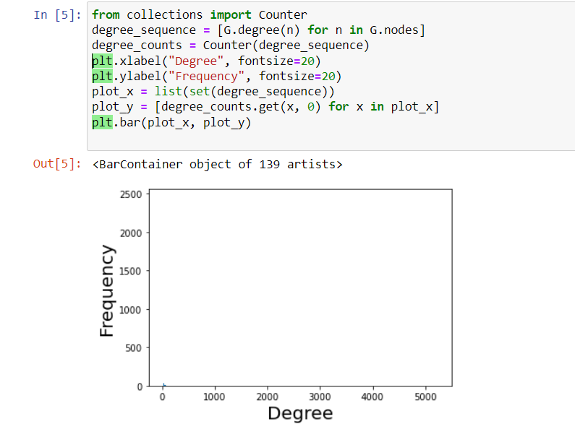
Visualization2:
Between Degree and Frequency

Slide 10
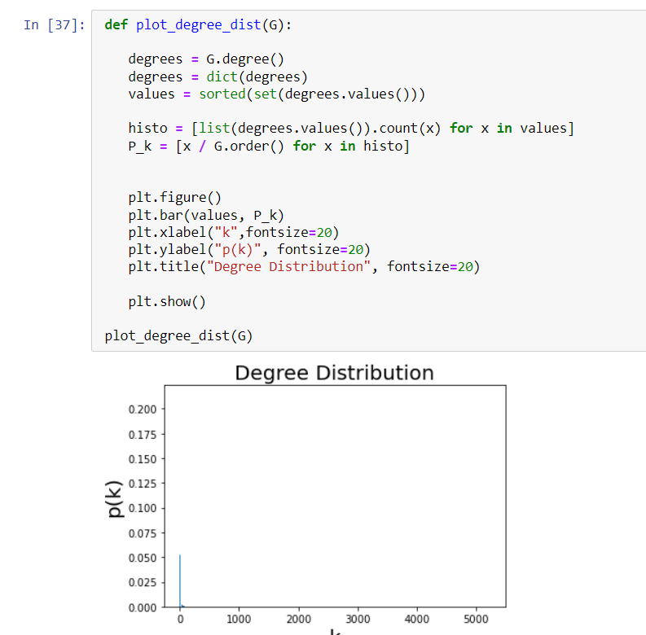
Visualization3:
Between K and P(k)

Slide 11
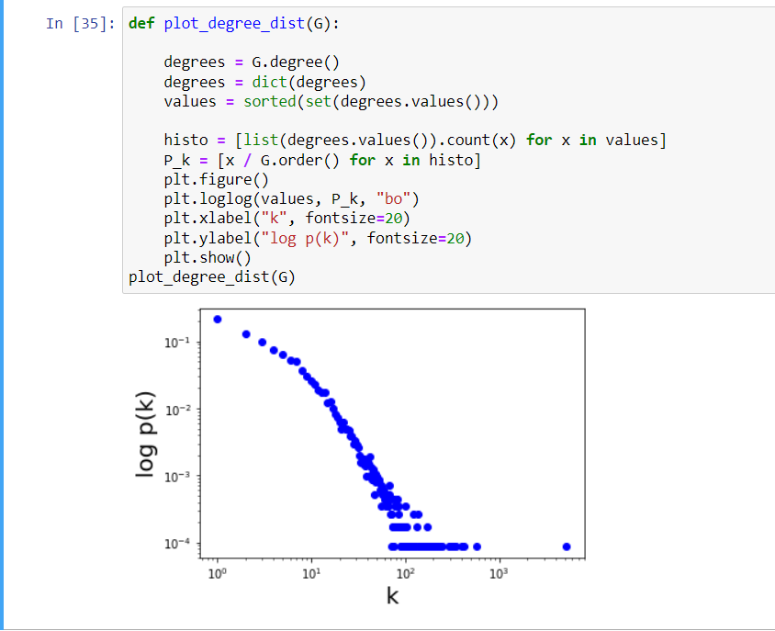
Visualization 4:
Between K and log P(k)

Slide 12
Hub proteins:
'P0CG48,P61956,P04637,P01106,P05067,P00533,P03372,P62805,P13569,Q13547,O60885,Q5S007,P07900,Q4G0J3,P63104,P62993,O60260,P35222,P38398,P68431,P31946,Q09472,P11142,O95793,P46937,P61981,Q92731,Q04917,Q16666,Q92769,P09651,Q13618,P36873,Q00987,P06748,P27348,P55072,Q9NRD1,Q7L2J0,Q9UKB1,Q13616,P62136,Q9Y297,Q92793,P62258,Q04206,Q9Y4K3,Q13263,P10275,Q92905,P12931,Q13619,P24928,P63165,P63208,P08621,P35637,P22681,Q13501,P05412,Q93009,Q9H967,Q16531,P12004,O00214,Q15910,P62837,Q16576,P67775,O00308,Q5TC82,Q9Y230,P50750,P08238,Q6P2Q9,P17980,P06400,Q09028,Q12933,P60484,P61964,Q9Y6K9,P30153,P27986,P62877,P24941,P43243,Q9BYD3,P40337,P17931,Q96CW1,Q05086,Q99459,P11021,P22087,Q9UNE7,Q16665,P09874,Q14839,Q15022,Q9UHK0,P51532,P35613,Q9NQC7,P53350,Q13620,Q13595,O95714,Q15717,P15880,P46934,P45973,Q13573,P31749,Q8N490,O15379,Q93034,P05161,Q96A08,O14965,P84022,O95292,Q15029,P40855,Q9Y265,P67809,Q96EV8,Q71U36,Q96ST3,P08047,P16104,P62241,O95274,P61077,O43291,Q86VM9,Q14498,Q96J02,P34932,Q02539,P29353,P51668,P10636,P49368,P50914,O75147,Q99496,Q16539,Q15370,P25963,Q9Y5K5,O00487,Q6P5W5,Q96CS3,P12956,P01375,P35232,P78371,Q9NP92,Q16543,Q15262,Q969H0,Q12834,P10809,Q9NWT6,P19784,Q9BRX9,Q08830,O96019,Q15648,Q9BYG3,Q13635,P43115,Q06124,O00182,O00165,Q15843,Q03405,P27694,O60939,P36941,P62195,Q8N5S1,Q96HE9,Q9GZQ8,Q8TAD8,Q9UBN7,Q16635,Q96EB6,Q9UMR2,P20036,Q86Y82,P20226,Q13363,Q13185,O43639,Q7L5N1,P62714,Q13617,Q92831,P49841,Q9NVR5,Q8IXZ2,Q9HD33,P83916,P98170,P55036,P60953,P60709,Q86WV1,P61289,Q99832,Q96ES7,Q9NQ29,Q14684,P54578,P19838,O14980,P42345,Q92633,O60341,P0CG47,Q8N5N7,P33993,P26368,Q96HY6,Q16854,Q6K0P9,O75489,P17987,O15524,P04049,P19338,P56524,P78527,O75376,Q9NZC7,P68400,Q15796,P29590,Q12873,Q96B97,A0JLT2,Q9Y4A5,Q86YD3,P13010,P27824,P28065,Q13309,P11940,P20248,P17844,Q9UEU0,P28482,Q9NPJ6,Q9NYK5,Q12905,Q13627,P00519,P04626,Q9H492,P31943,P06241,Q9BTT4,Q15165,Q13490,Q9Y383,Q9NWS0,Q92993,P49336,Q14258,P09661,P53611,P06493,Q14999,Q9H8V3,Q14974,Q01094,P0DMV8,Q13546,P38936,O43318,P19388,O95402,P15927,P30260,Q00839,Q00610,P63000,Q13330,P48431,O94776,O75530,P60033,P47755,Q9H204,P02545,P25445,O14920,Q15369,P25490,P42224,B3KNW7,P26358,Q9UI95,P68036,Q15884,O94992,P78317,Q9BXW9,P24385,Q9UBU9,P17040,Q13114,P40763,P38919,O15111,Q7Z6Z7,Q9UM11,Q92922,Q14457,Q96GS4,P61962,Q8NFB2,O95619,Q9HCE7,P61586,Q12888,P10398,Q05397,Q02878,O00567,Q13200,P37173,Q86VU5,Q15428,Q05513,Q06609,Q96GM5,Q9Y618,Q9UHD2,O15400,Q9NWA0,Q9Y5M8,P61081,Q9UBU8,P37840,Q96GD4,P50991,P35998,Q08211,P63244,Q96PU5,P25787,Q9UNS2,P10415,P05556,P04150,Q93074,Q13503,O95994,Q9Y4X5,Q92900,Q14145,Q9Y275,P62079,Q9HBV2,P51665,Q92830,Q06587,P61201,O95863,P40227,P29350,Q66LE6,Q9UGM1,Q8WXA8,Q9UHV7,P63279,P04798,Q401N2,Q9UER7,Q676U5,Q53F19,Q9H244,P46108,P13727,P62140,Q9UGY1,Q9UNN5,Q8WVE6,Q5SW79,Q9UNX3,P19174,Q13077,P48643,P25786,P54252,Q7Z434,Q14790,P10276,P46940,Q969G3,Q9NX70,Q9NWB7,Q9Y5U2,O95721,Q9NS91,P19438,Q9NU53,P23258,P04792,P62917,Q96JC9,Q9HCE1,P62191,Q15788,P35226,Q8TAQ2,Q8TDD5,P52799,P80370,Q13084,P15056,Q14103,Q9NRD5,P43355,P31947,O15294,P32121,P08754,Q12824,Q9Y4E8,Q13451,P51610,Q9UQL6,P37231,P51531,P61244,Q9UKV8,Q9UKV5,Q9BUE0,Q03135,Q8N488,O75528,Q96EP0,P46527,Q13485,Q8NFZ5,O15169,Q09161,P25788,P49736,Q15291,P43686,Q14676,P11362,O95071,O60244,P50613,Q16827,Q8IY57,Q9UNP9,P07437,Q02297,O75533,O14498,Q13033,Q9H0M0,O15165,Q15008,P49746,Q13489,Q9NVC6,P62487,P24863,Q9H5K3,Q96KQ7,P15408,P0DP23,Q8N122,Q99728,Q9NZQ7,Q9Y4B6,O14958,Q8N8Y5,Q13283,Q03164,P62333,Q16186,Q07817,P21860,Q16637,Q9NV96,Q96C28,Q9Y2M5,Q9P0L0,O75643,Q9ULK4,O43513,Q3KPI0,Q8NHY2,Q92665,Q9Y3I1,Q9Y2G2,P13747,P84243,Q9BXM7,P42566,Q9UKX7,P60900,Q99683,Q8N205,P16333,Q15365,P0CAP2,Q13509,Q9UBL3,Q92838,Q9BQ95,P51970,O60674,Q14686,Q9UJX5,Q5BKU9,P02511,Q6ZWI9,Q9BWU1,P19387,O75448,Q9UHD9,Q9BT78,Q8WVZ9,Q15691,Q02083,Q07021,P61088,P54132,Q13315,O94763,Q9BRS2,P29016,O43815,Q9UHW5,O15105,Q12962,Q99436,P28070,P61978,P08069,O00303,O60566,O60264,O95983,O14763,Q00613,P56945,Q6UX41,P48729,Q9H944,P30876,Q8N5Z5,P21580,P01112,Q03468,O75367,P0C0S5,Q8WUI4,P51587,O43791'

Slide 13
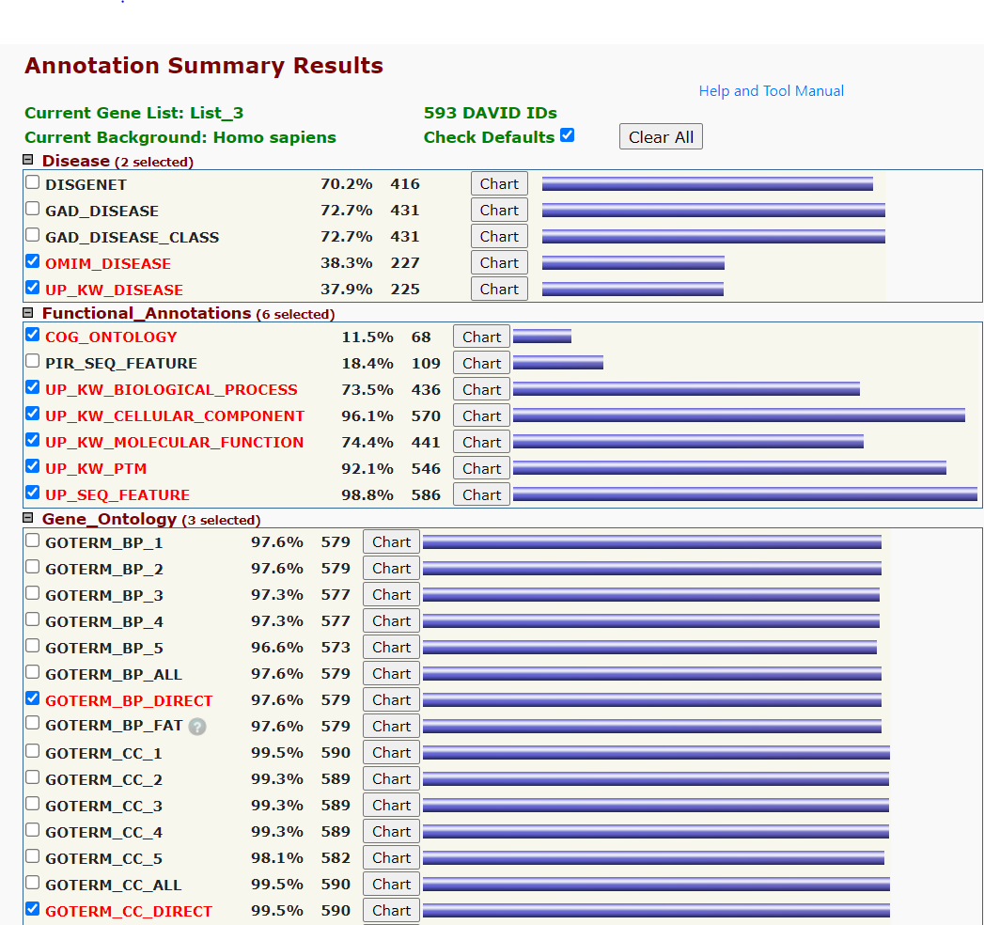
DAVID Annotation Tool Annotation Summary Result

Slide 14
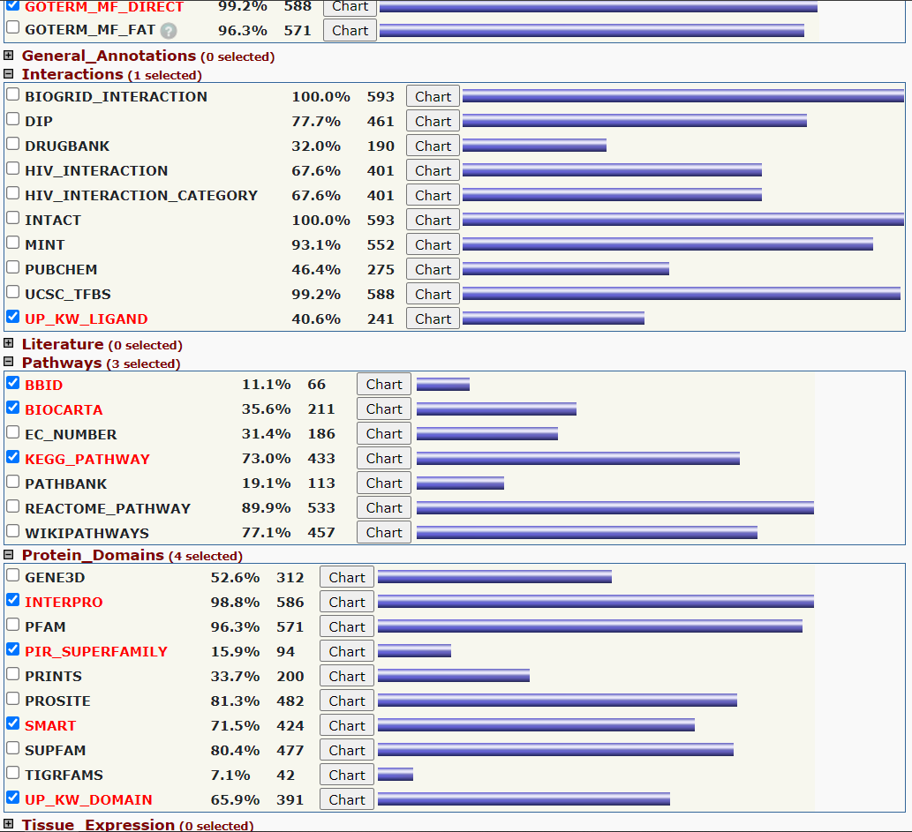

Slide 15
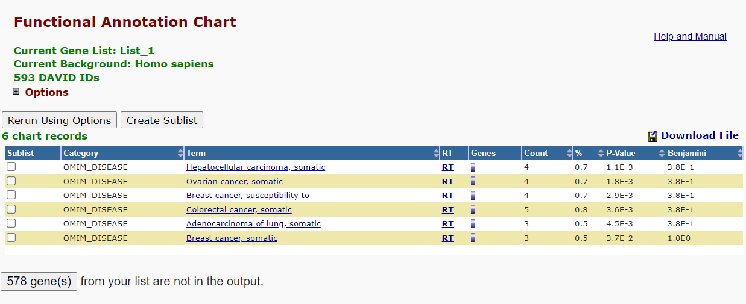

Slide 16
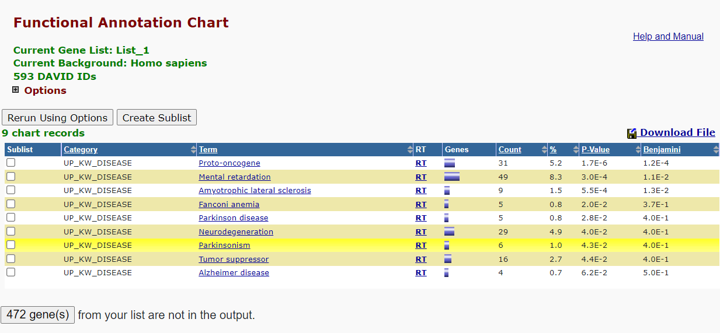

Slide 17
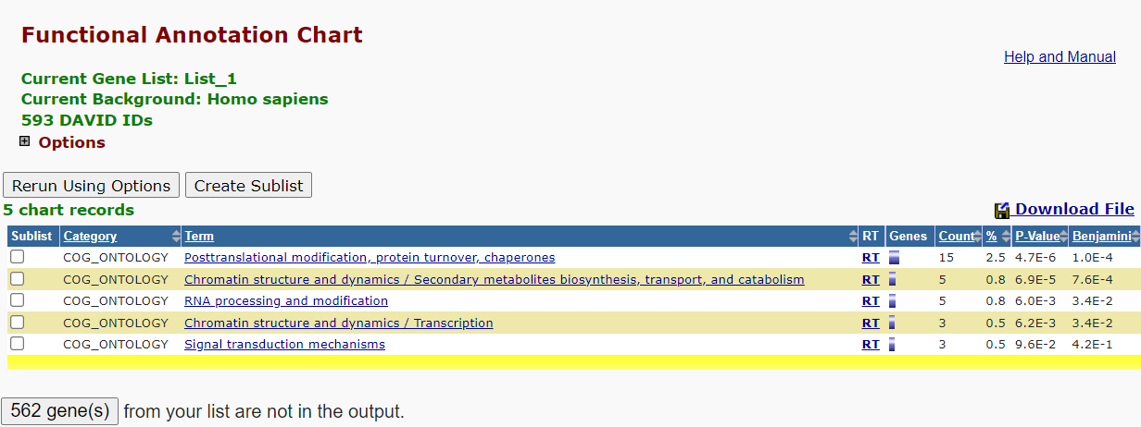

Slide 18
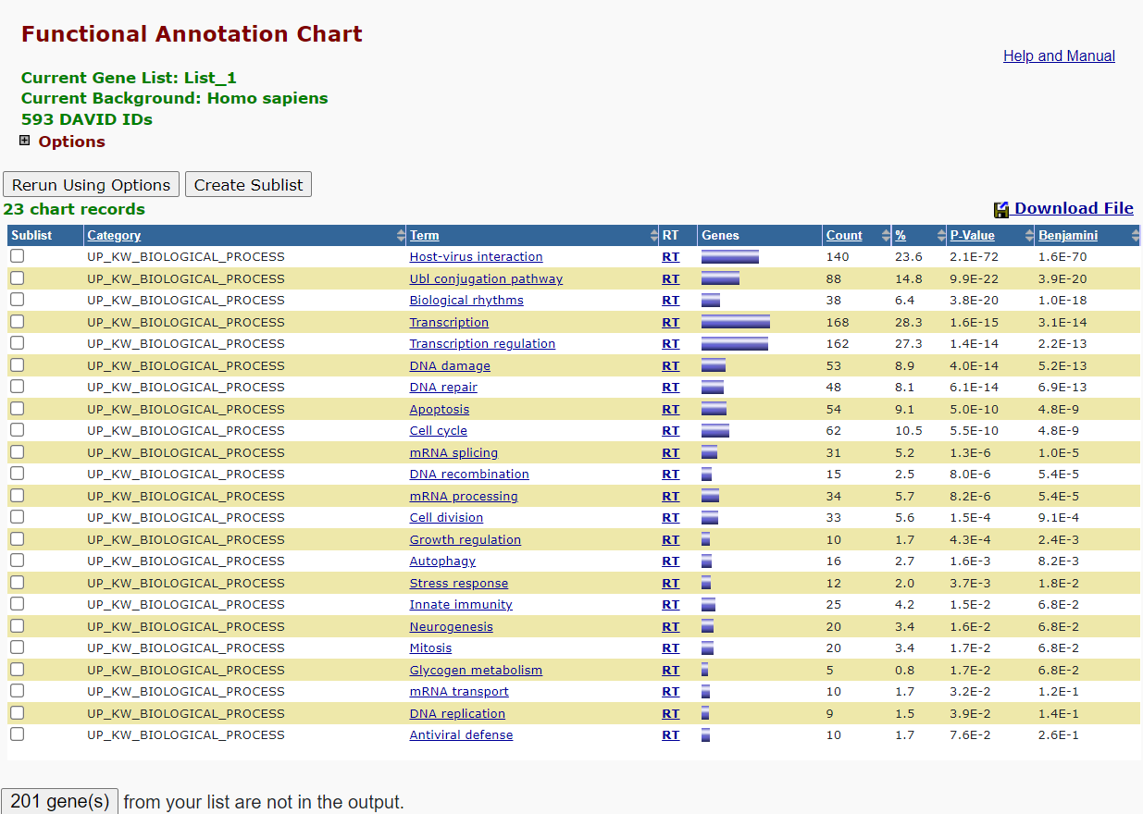

Slide 19
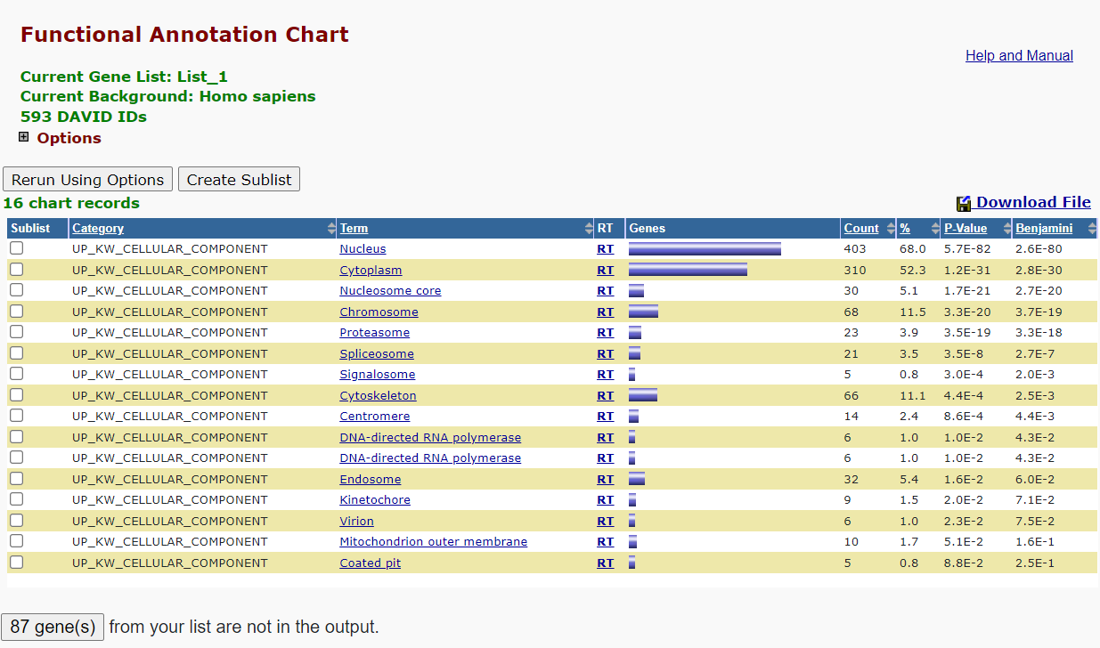

Slide 20
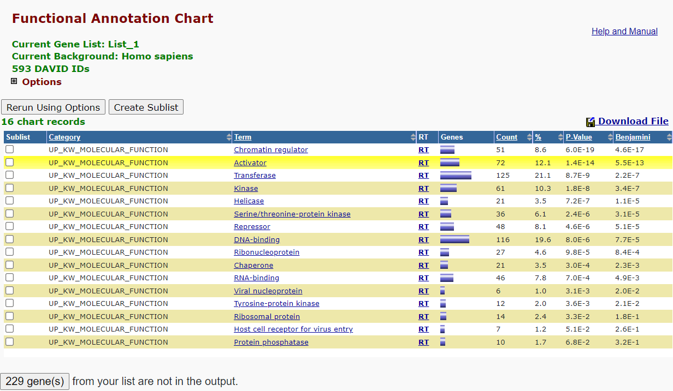

Slide 21
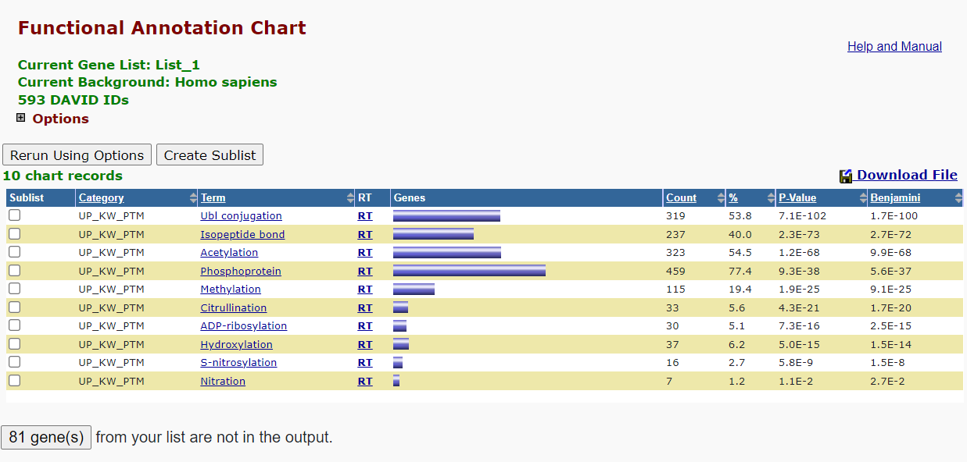

Slide 22
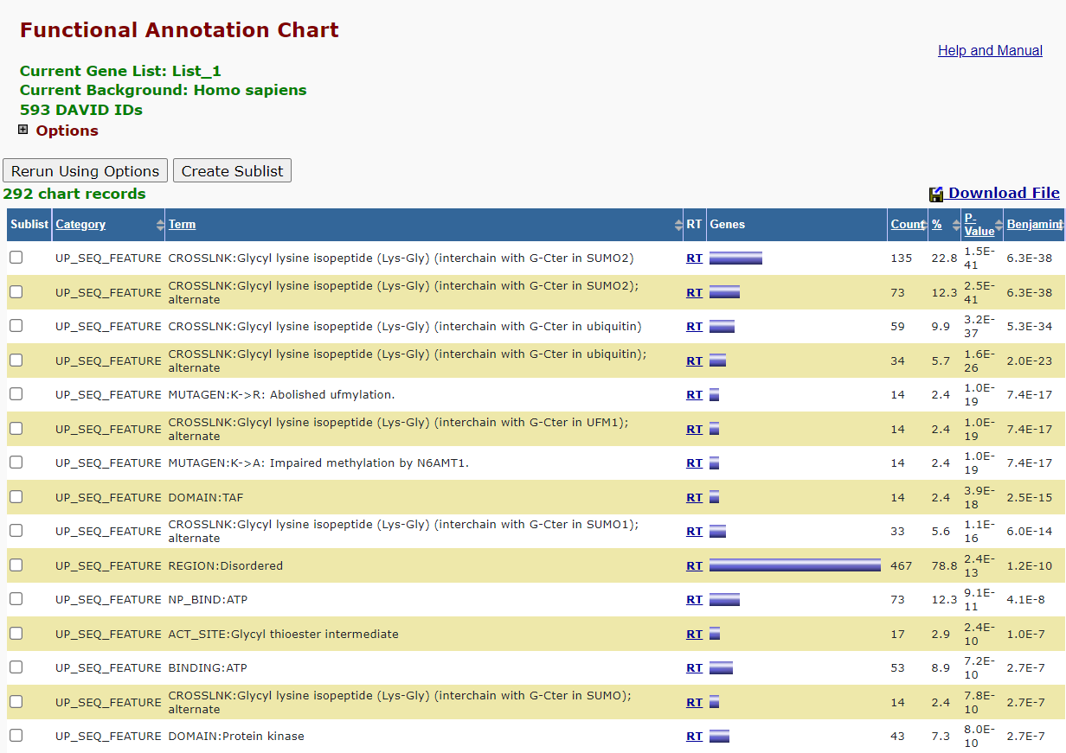

Slide 23
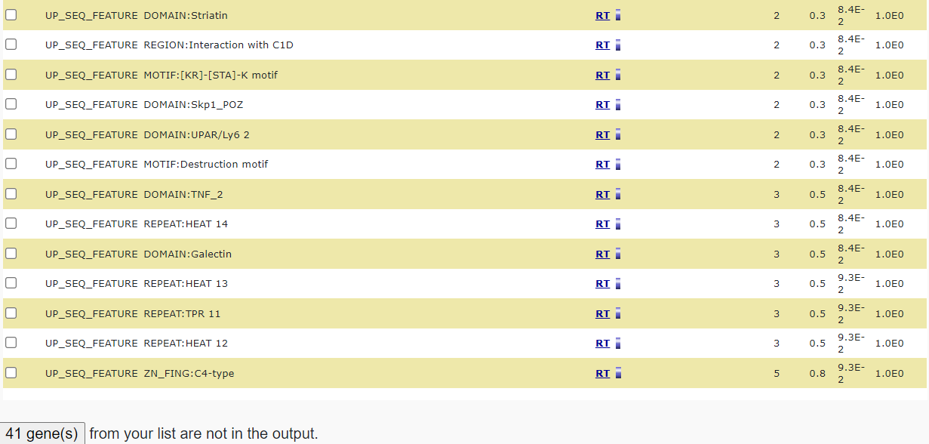

Slide 24
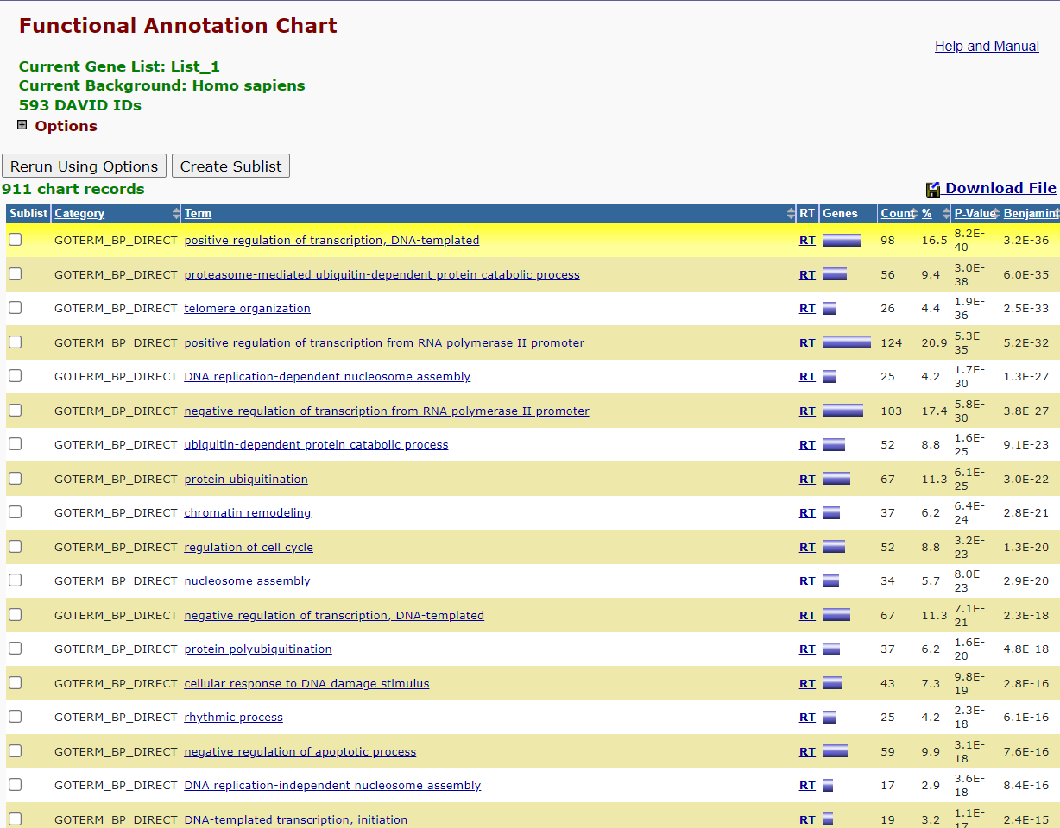

Slide 25
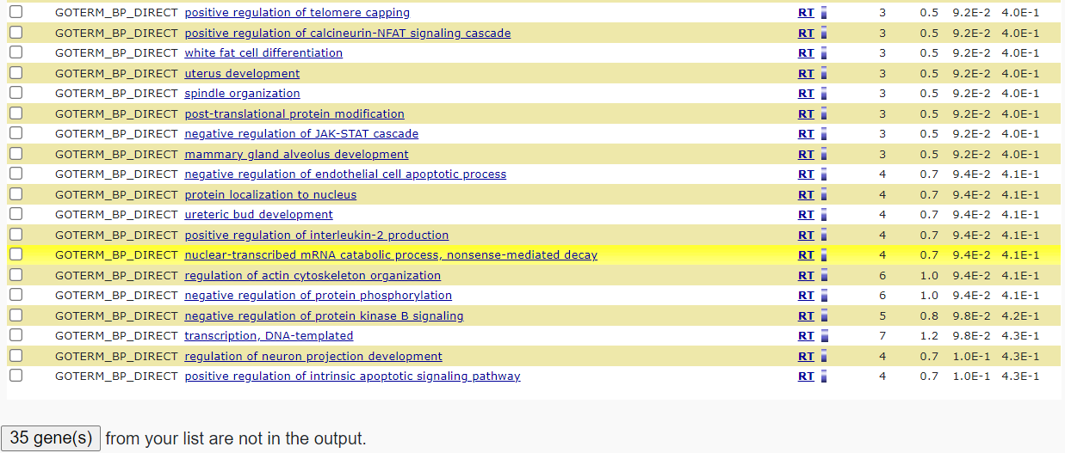

Slide 26
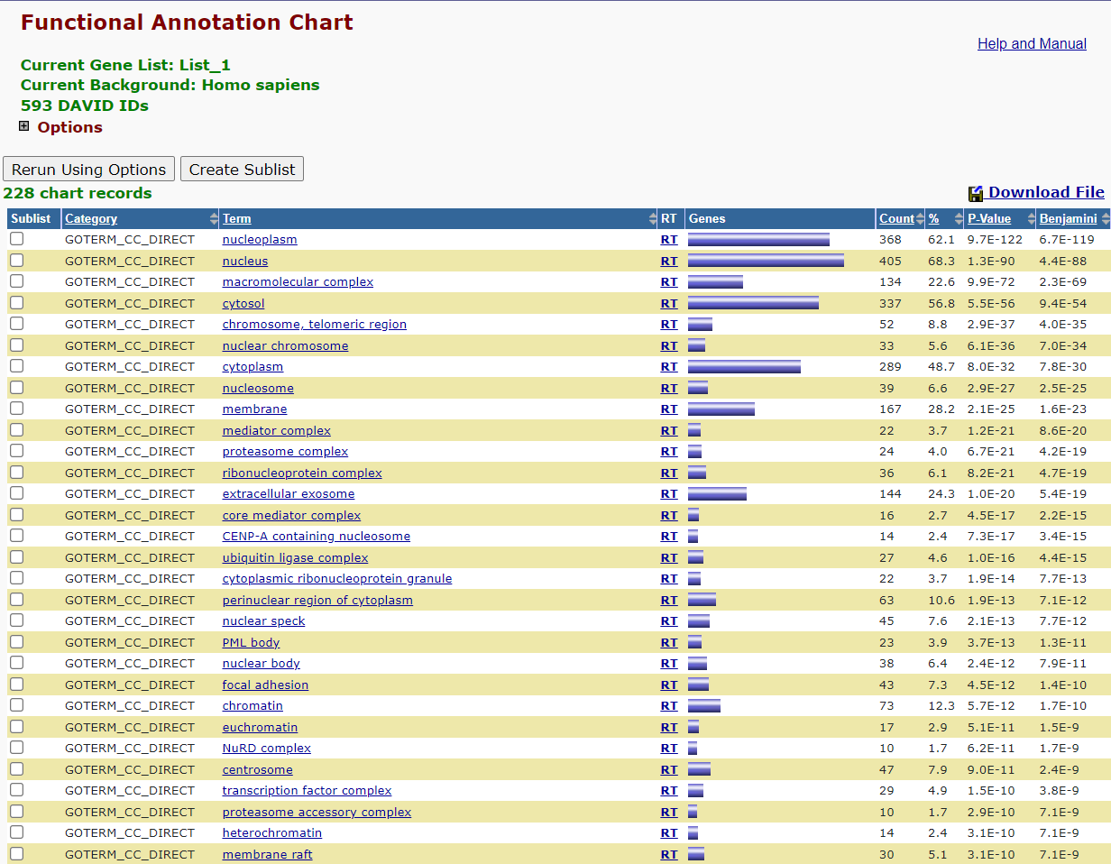

Slide 27
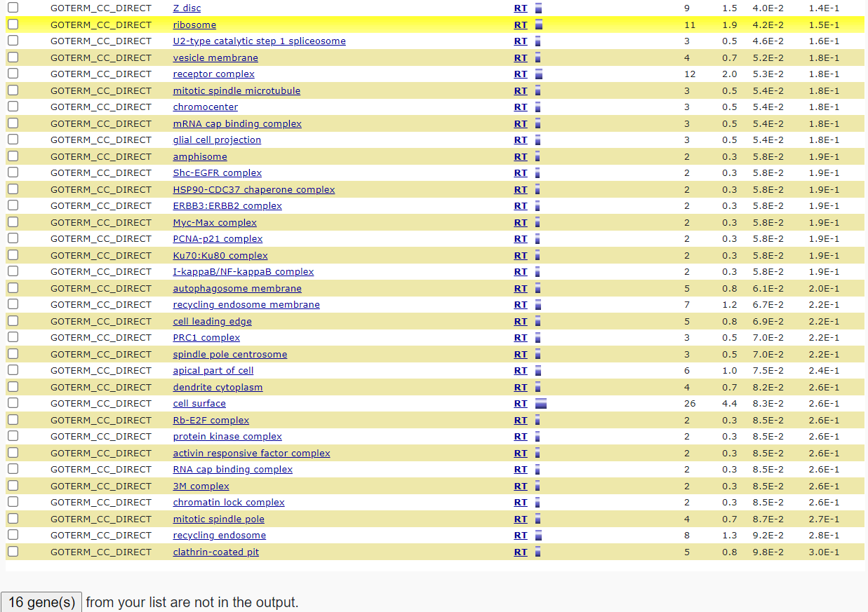

Slide 28
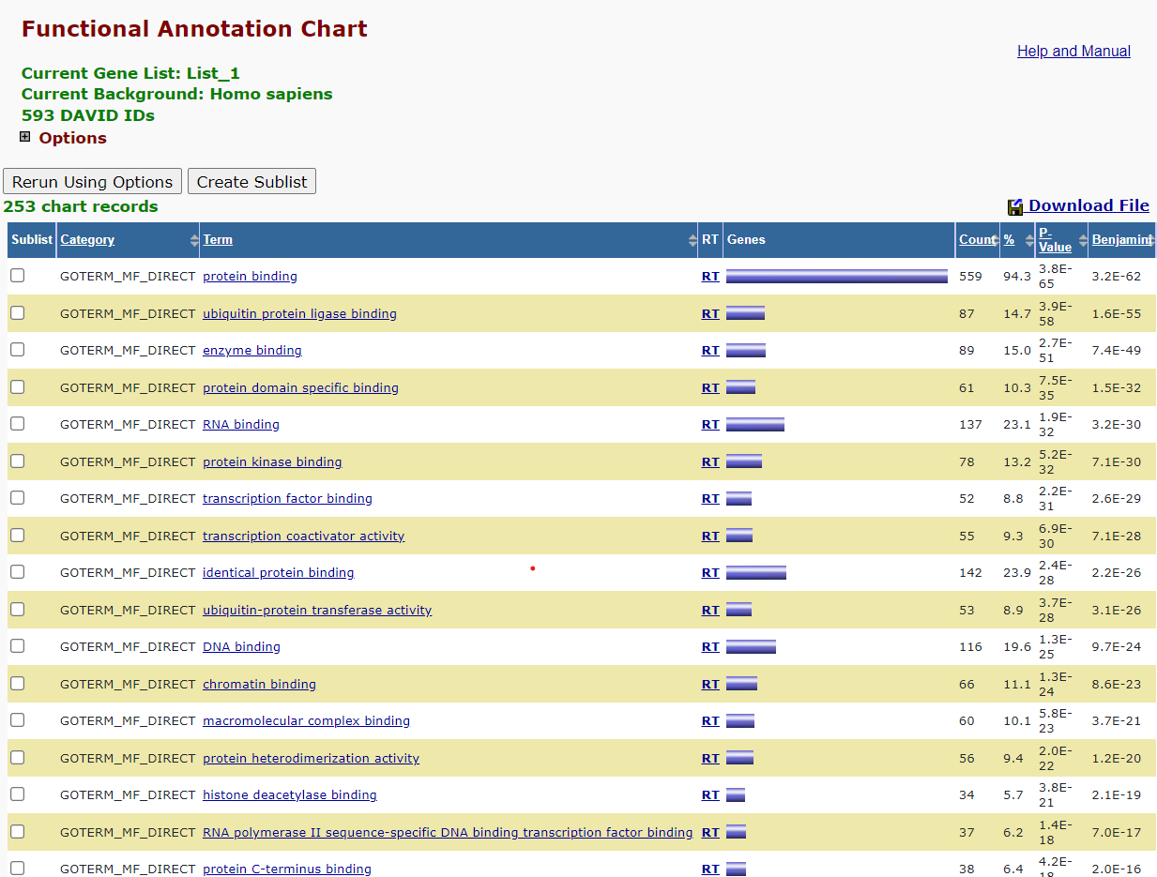

Slide 29
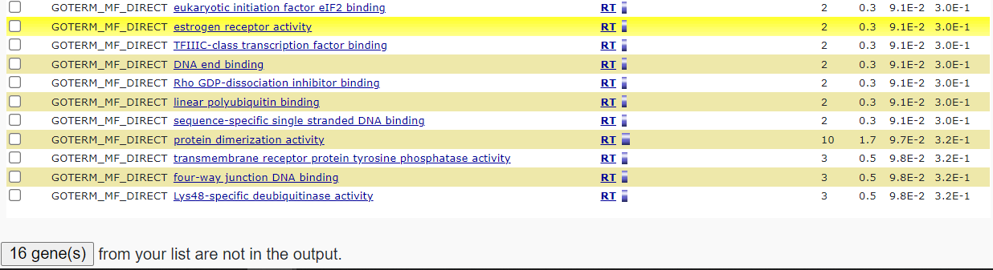

Slide 30
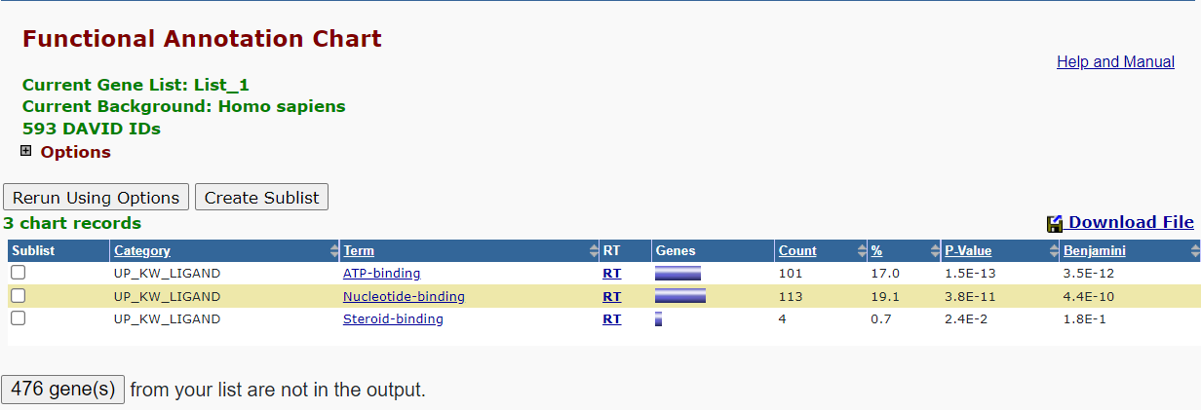

Slide 31
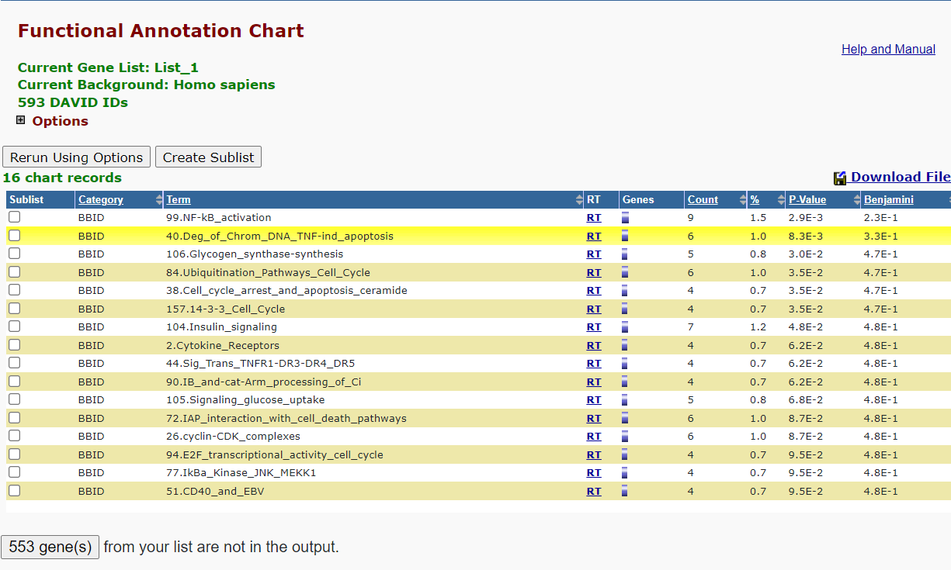

Slide 32
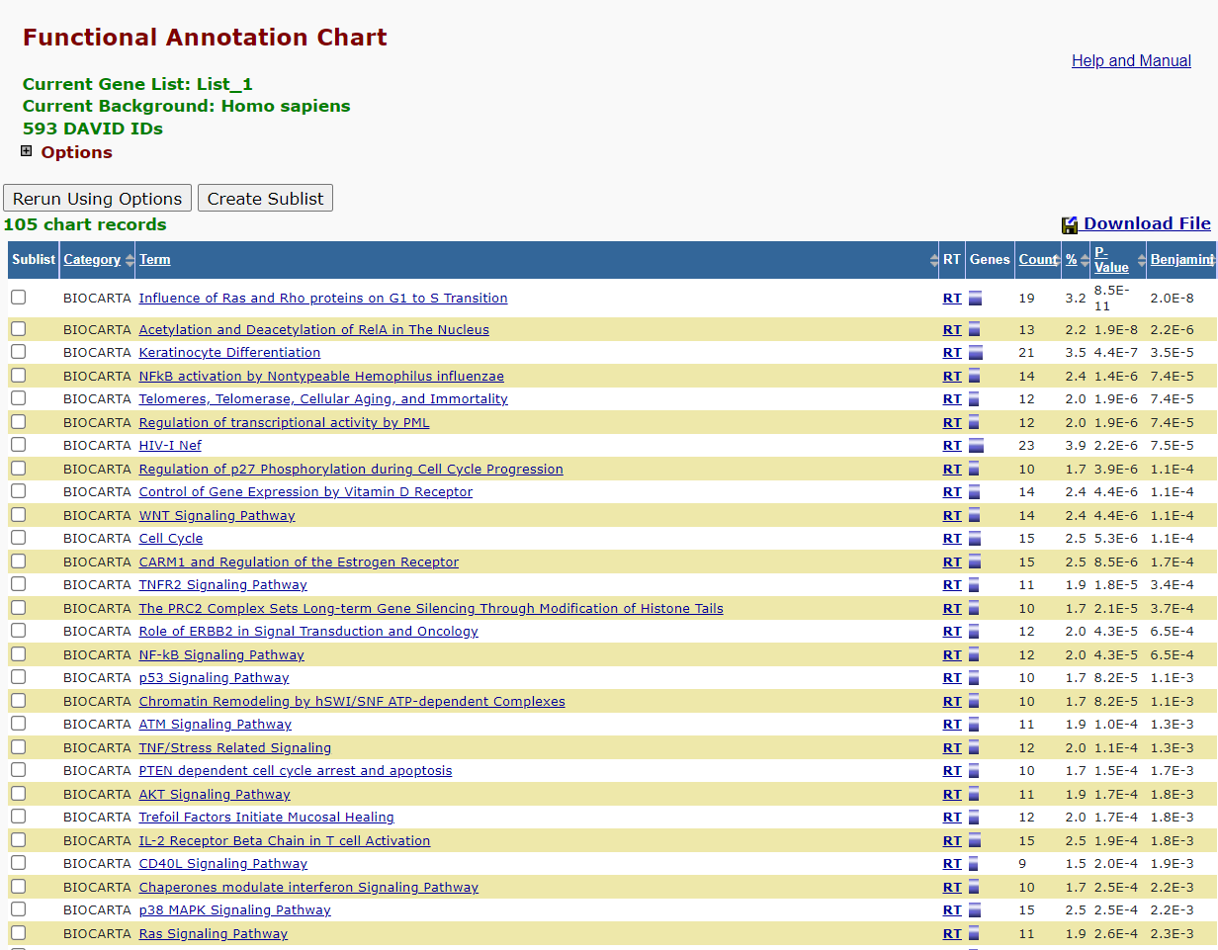

Slide 33
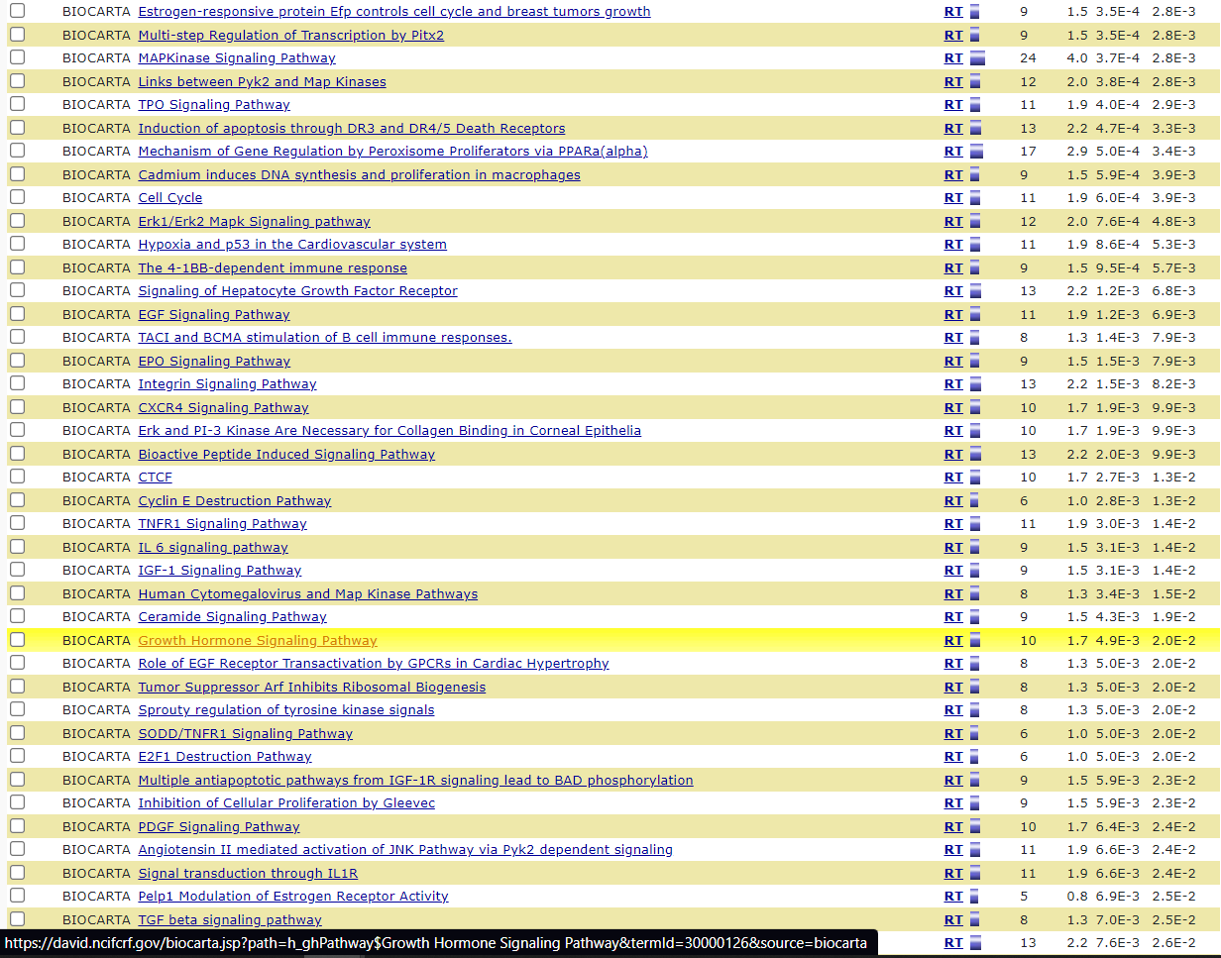

Slide 34
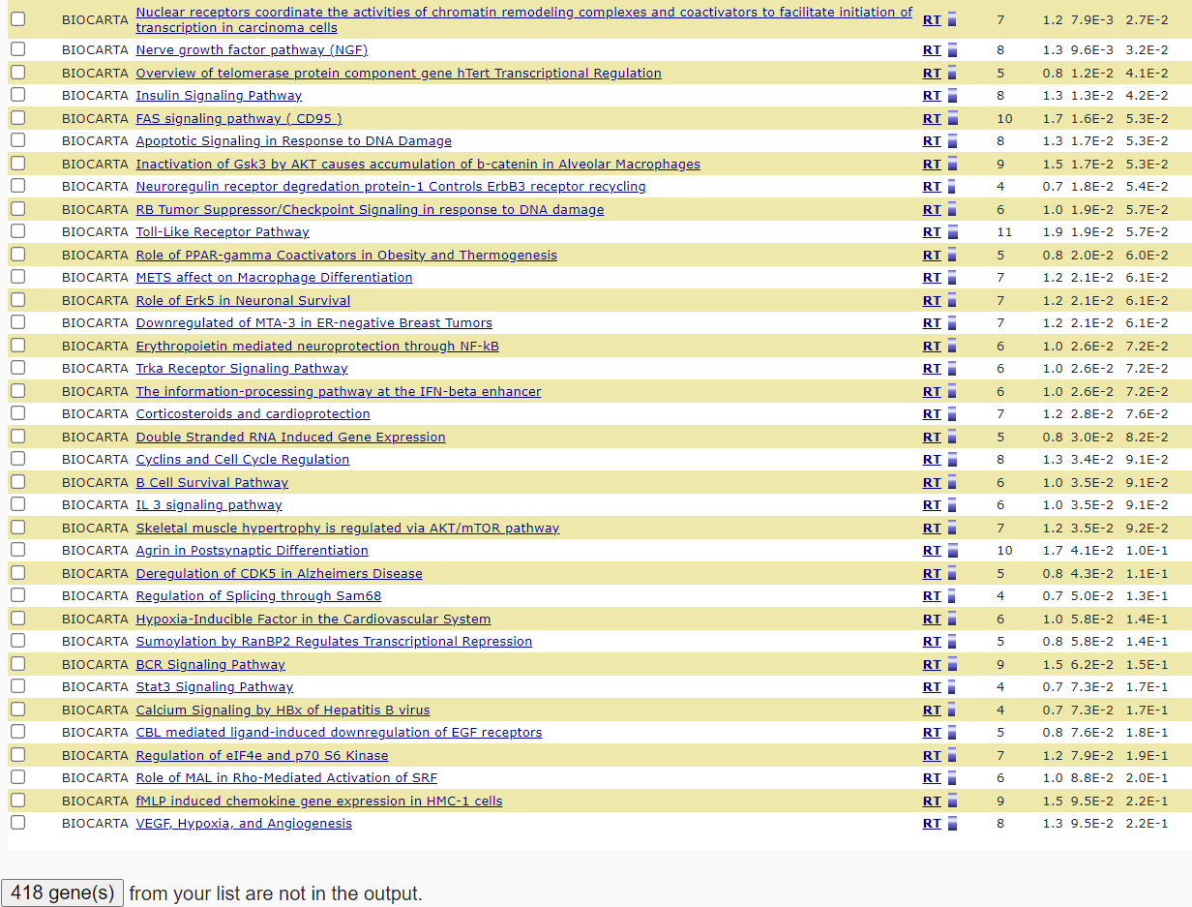

Slide 35
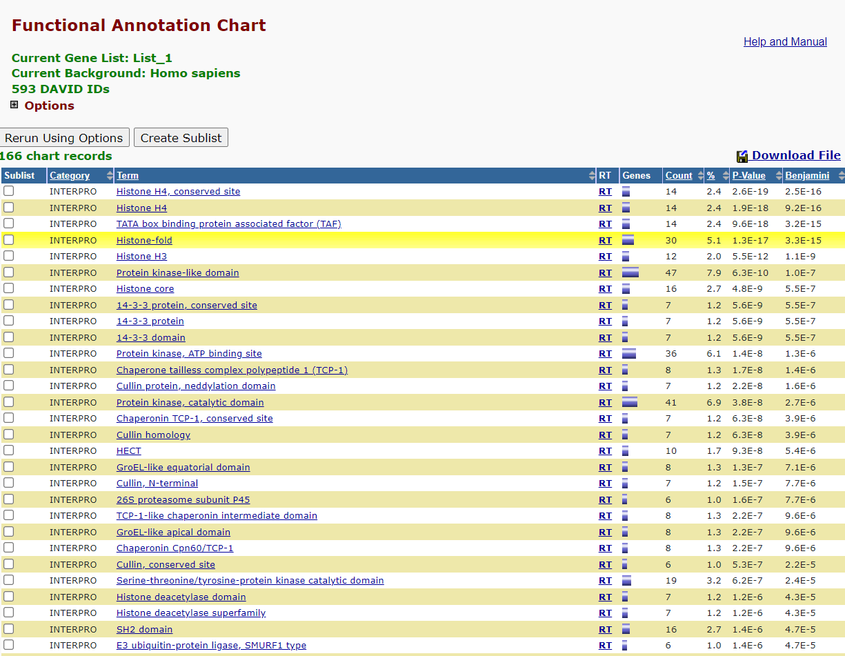

Slide 36
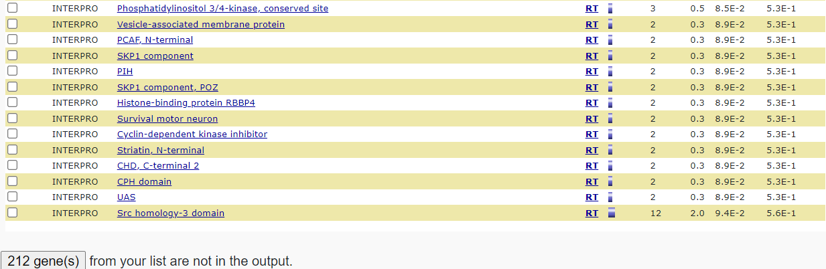

Slide 37
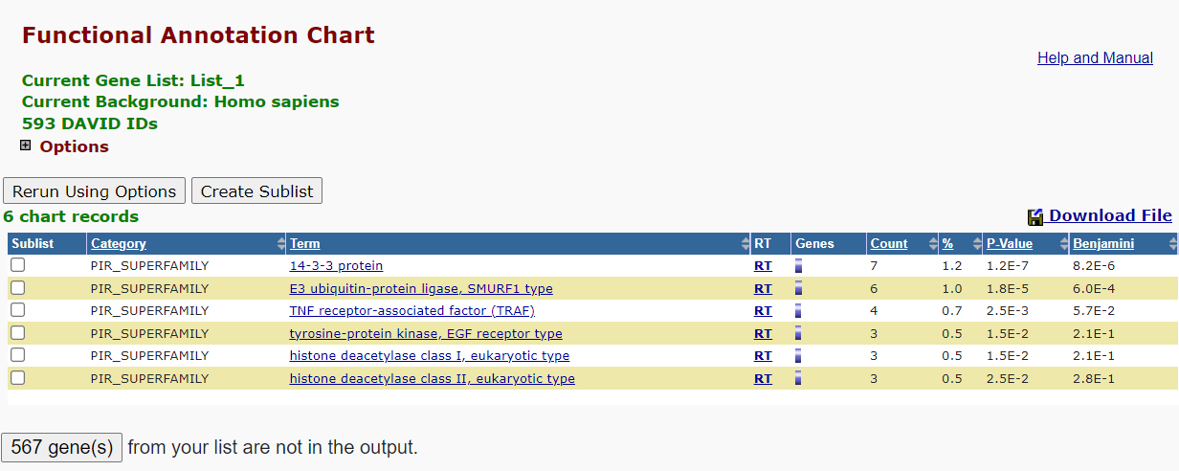

Slide 38
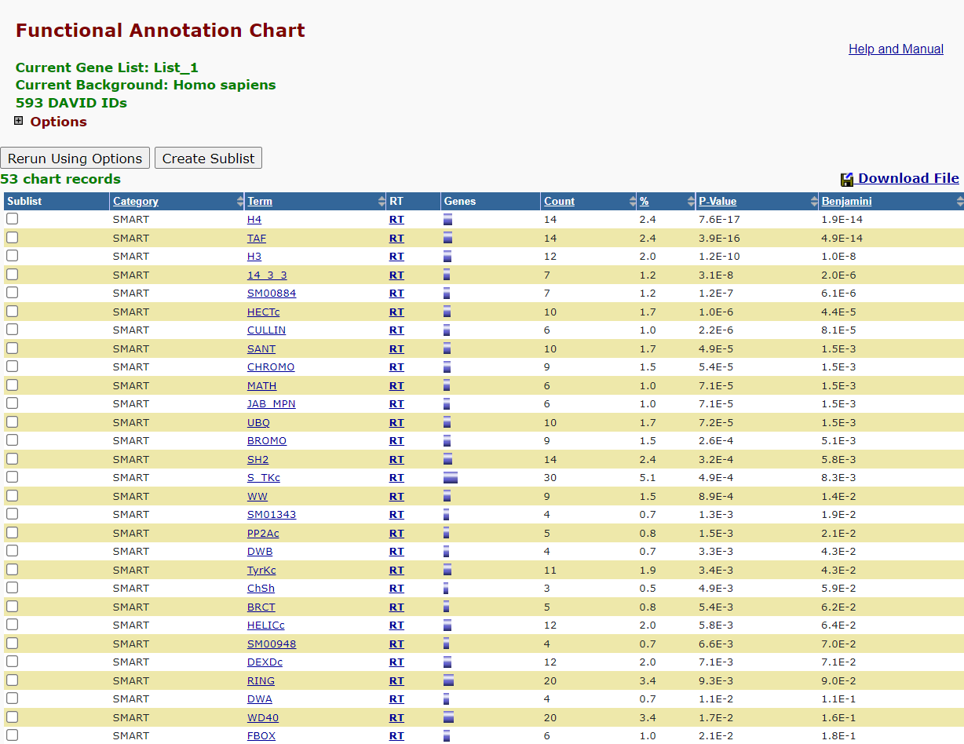

Slide 39
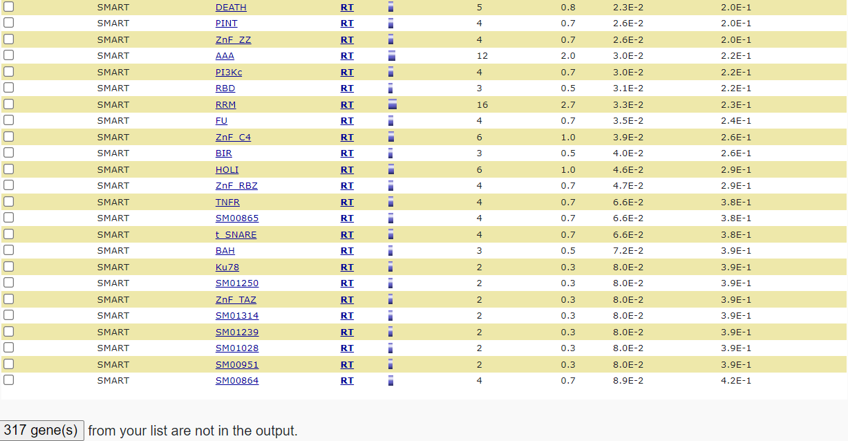

Slide 40
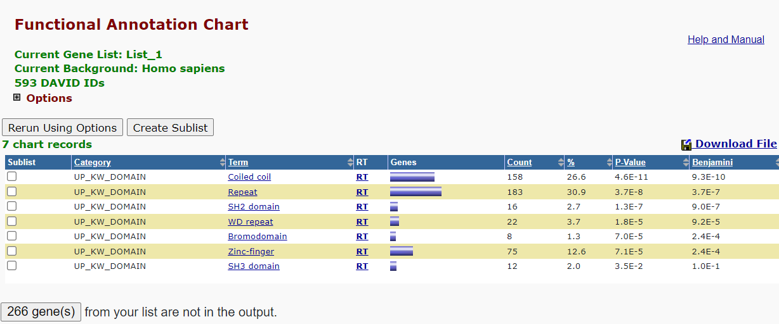

Slide 41
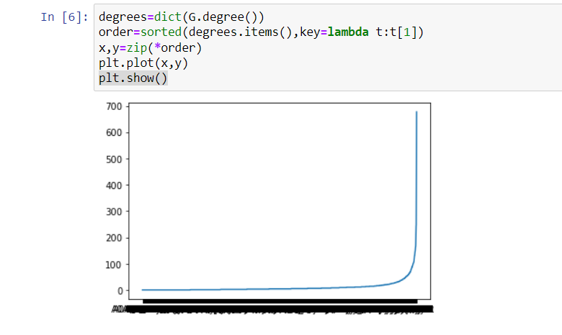
Second File(E-coli): EscherichiaColiK12_cocomp_hq.txt
Visualization 1:
Between nodes and their Degrees

Slide 42
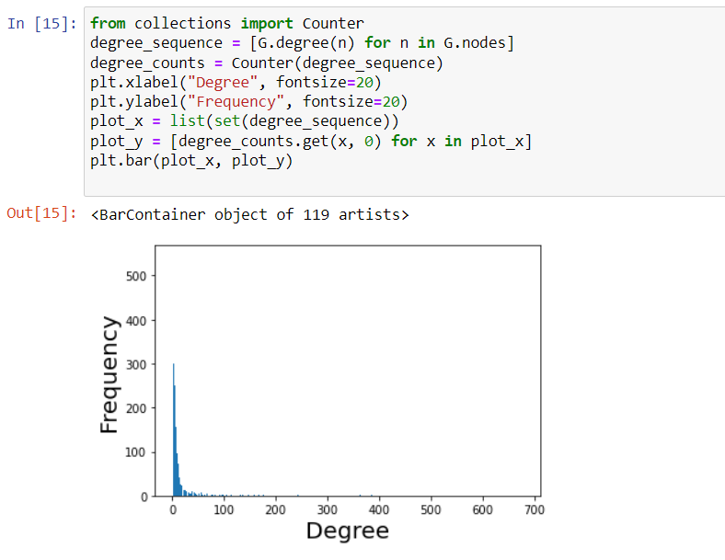
Visualization2:
Between Degree and Frequency

Slide 43
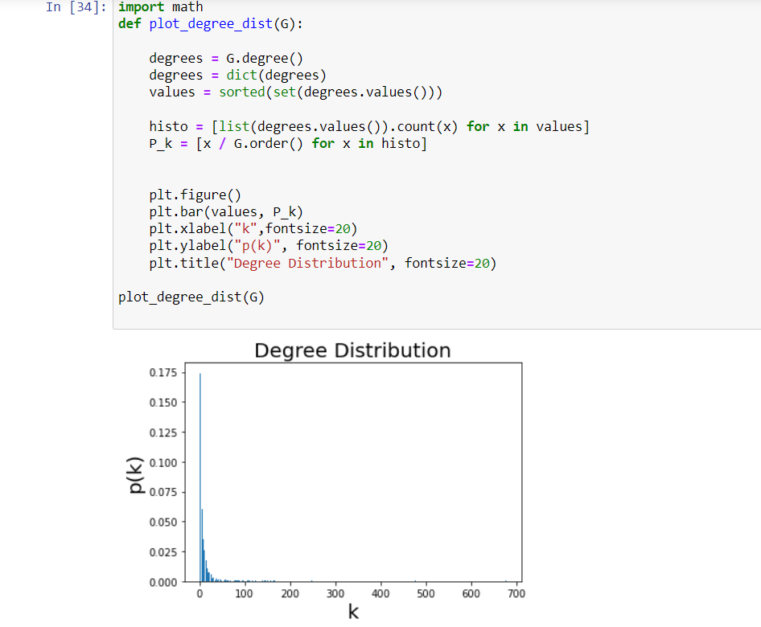
Visualization3:
Between K and P(k)

Slide 44
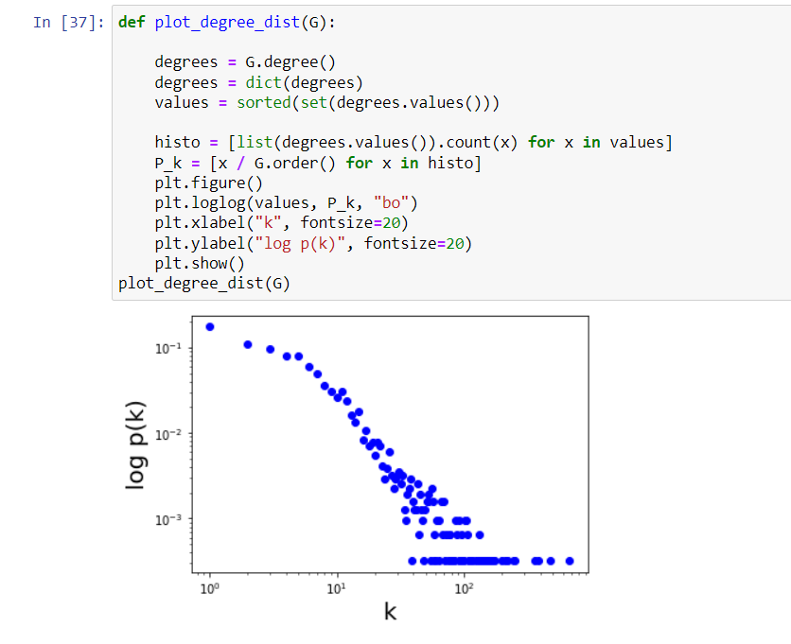
Visualization 4:
Between K and P(k)

Slide 45
Hub proteins:
'P0A6F5,P18843,P60422,P0A6Y8,P60723,P0A7V8,P0A7V3,P0A7V0,P0A7W1,P0CE47,P0A7M2,P0A7L0,P0A717,P0A7X3,P02359,P60438,P0A7K2,P0AG44,P0AA10,P0A7K6,P0CE48,P0A9K9,P0A7S9,P61175,P0A7R5,P0AG59,P0A8T7,P0ACF0,P08622,P0ADZ0,P0AG67,P0AFG8,P0AG48,P0A7U7,P0A6F9,P0A850,P0A9P6,P0A8V2,P37765,P0A7Z4,P36979,P02413,P10408,P0AGJ5,P0AG55,P13035,P0A7T3,P0A9Y6,P0A9P0,P0A7R1,P39177,P62399,P0AC41,P0ACF4,P06959,P63284,P0A9X4,P0A6X3,P02358,P0A9M0,P02918,P60624,P0A8M6,P0ABH9,Q8VNN2,P37751,P0ABT2,P0AA39,P21499,P0A7J3,P10443,P0AG30,P0ACF8,P67910,P15288,P0ADY7,P0DP90,P0AG24,P0AAS7,P0A6G7,P0AGK4,P0A707,P0A7Y8,P21645,P06612,P0AGJ6,P0AFG0,P22523,P09373,P0A9K3,P0A6P9,P0A6Z3,P0A7N9,P0A8N5,P0A776,P0A7L3,P0A7J7,P0ADK8,P0A8E5,P0A7E9,P0A988,P0ADY3,P0A9A9,P0A972,P0A705,P28043,P0A6M8,P0A6W5,P0A843,P21513,P0C054,P0A6A8,P75864,P76104,P09372,P75829,P0A715,P77188,P0ABU7,P36659,P08245,P0A8M3,P0AEM0,P0AES4,P42184,P0A9K6,P09546,P05055,P69913,P0A6B7,P0AC53,P0A6H5,P0C018,P0A7M6,P0A8G0,P0AFF6,P23830,P0A9W0,P0A7A9,P14081,P0A8I5,P0AFP6,P0A8E6,P0A901,P0AA43,P68066,P0AE08,P0A9X9,P0A847,P0A6Q3,P0AD61,P0A9B2,P0A9A6,P0AED5'

Slide 46
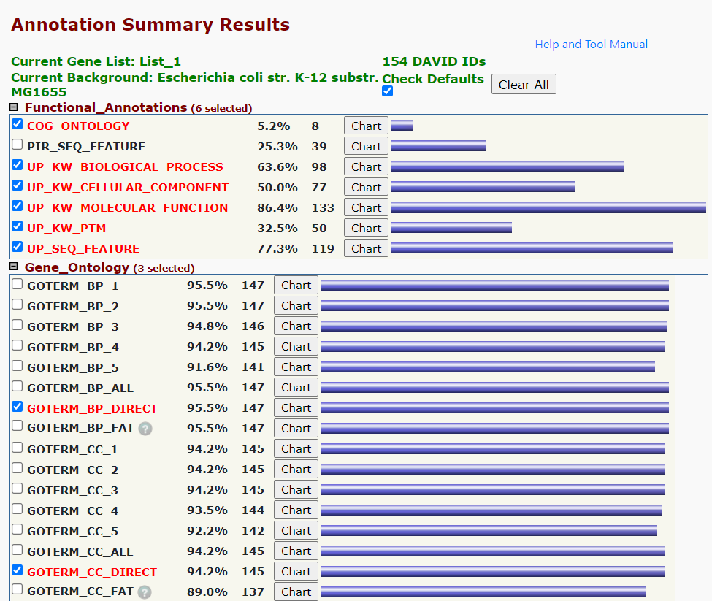
DAVID Annotation Tool Annotation Summary Result

Slide 47
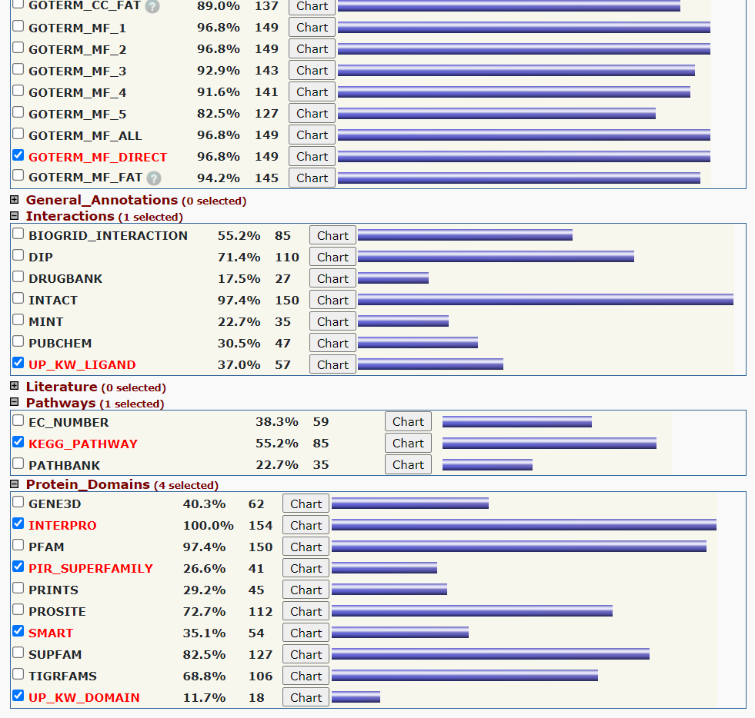

Slide 48
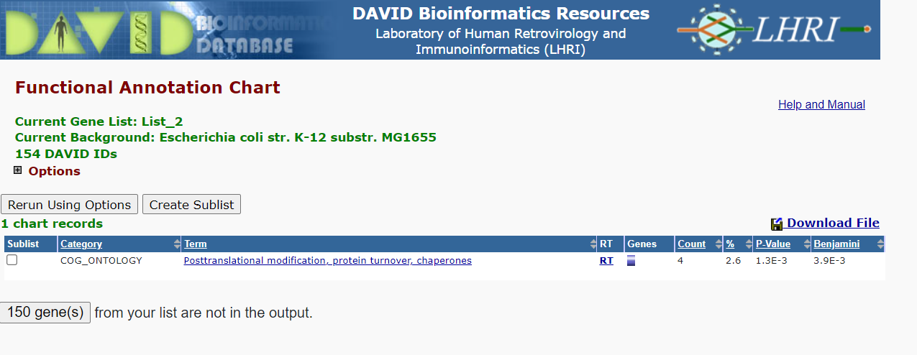

Slide 49
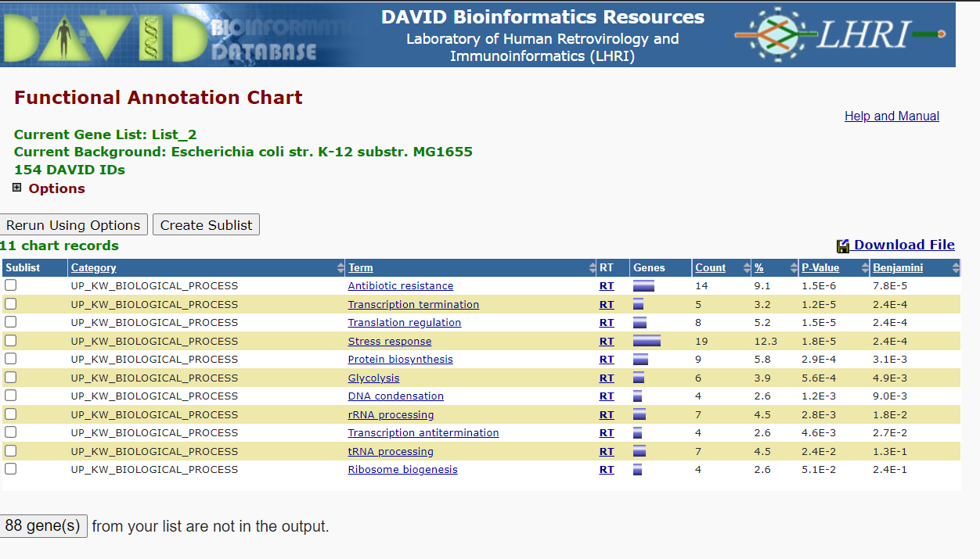

Slide 50
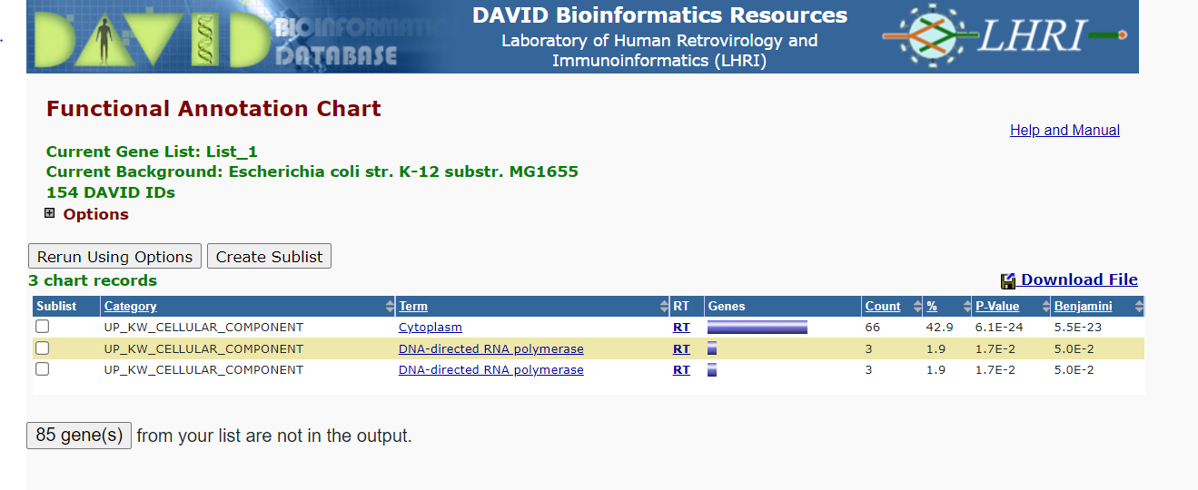

Slide 51
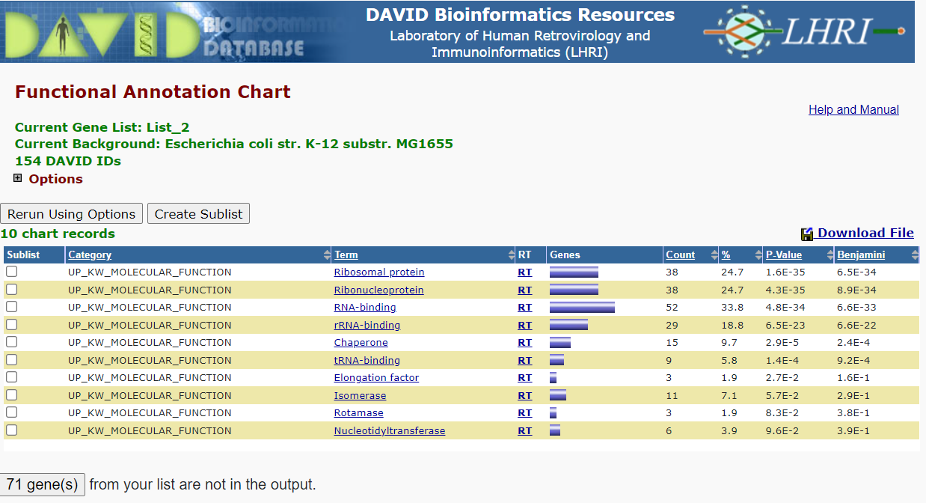

Slide 52
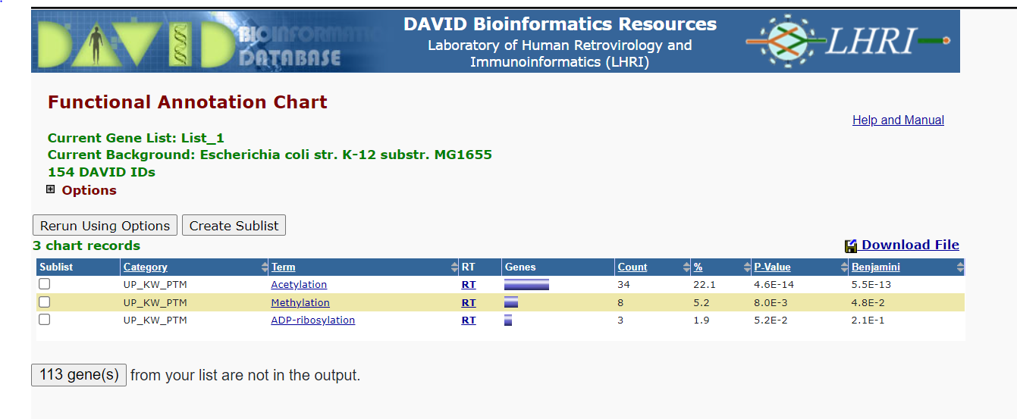

Slide 53
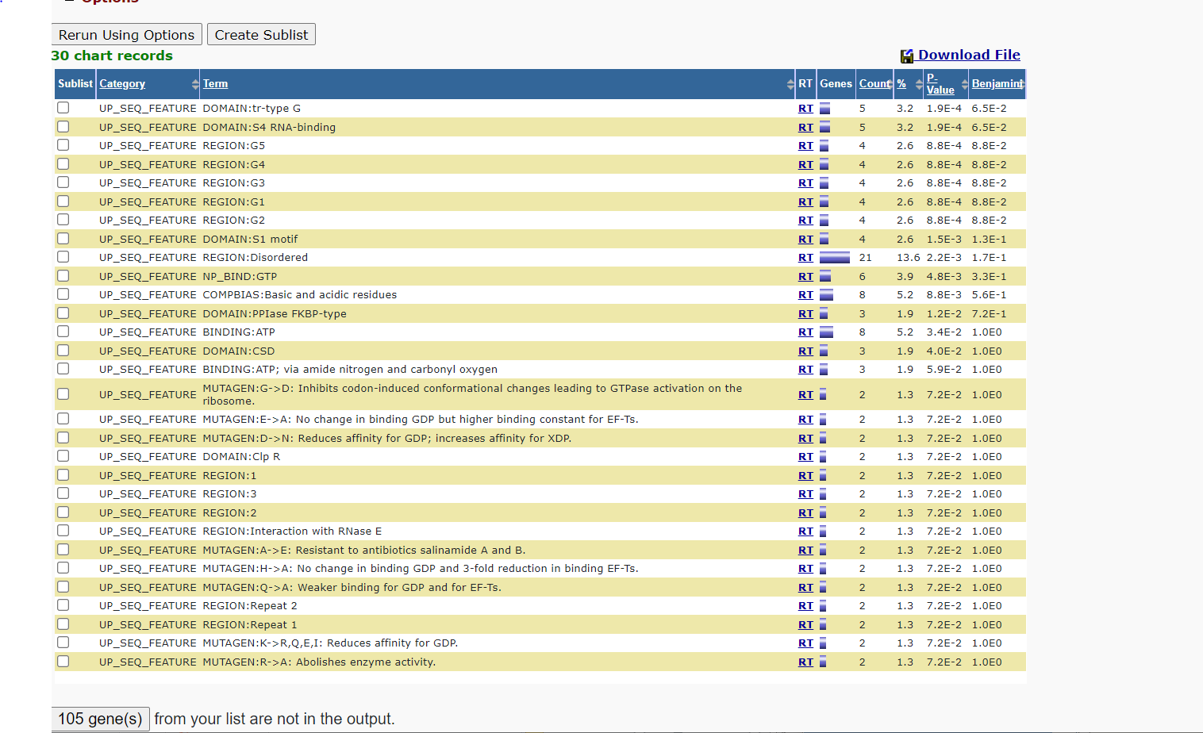

Slide 54
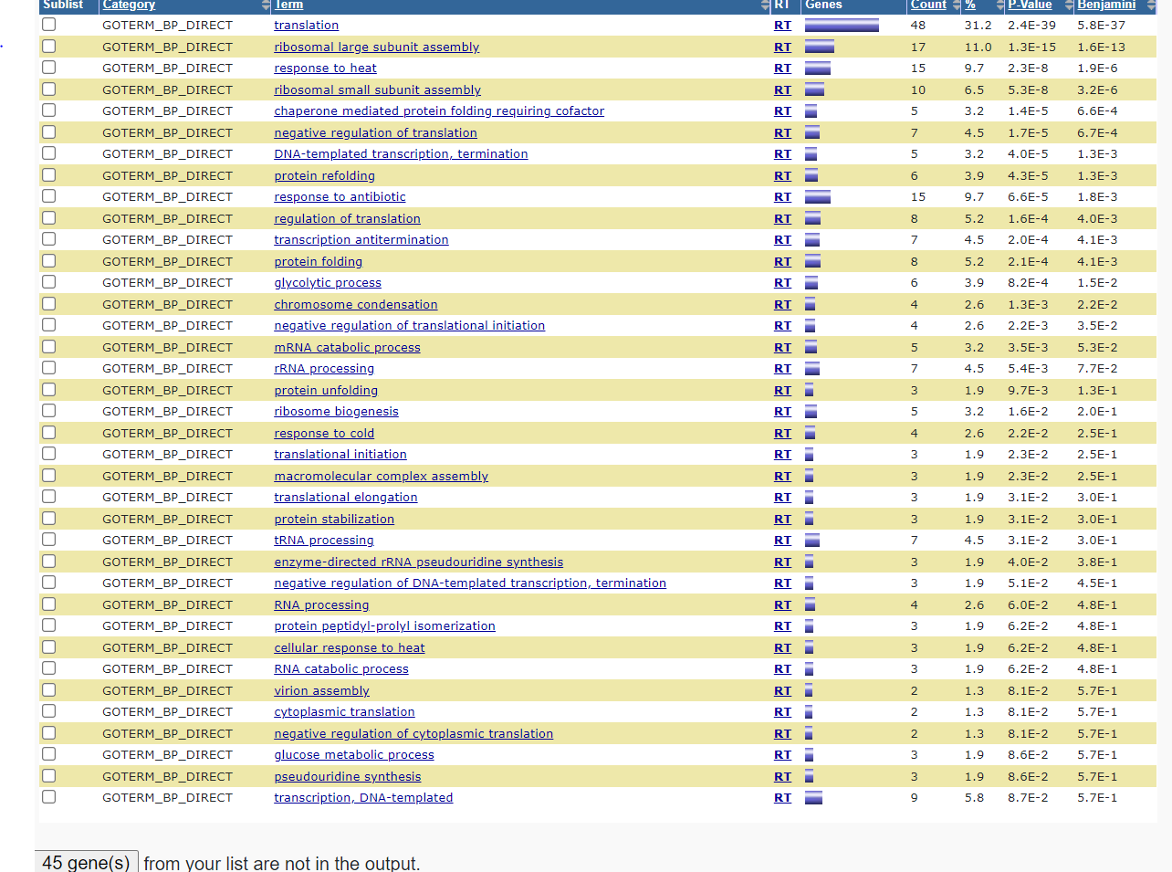

Slide 55
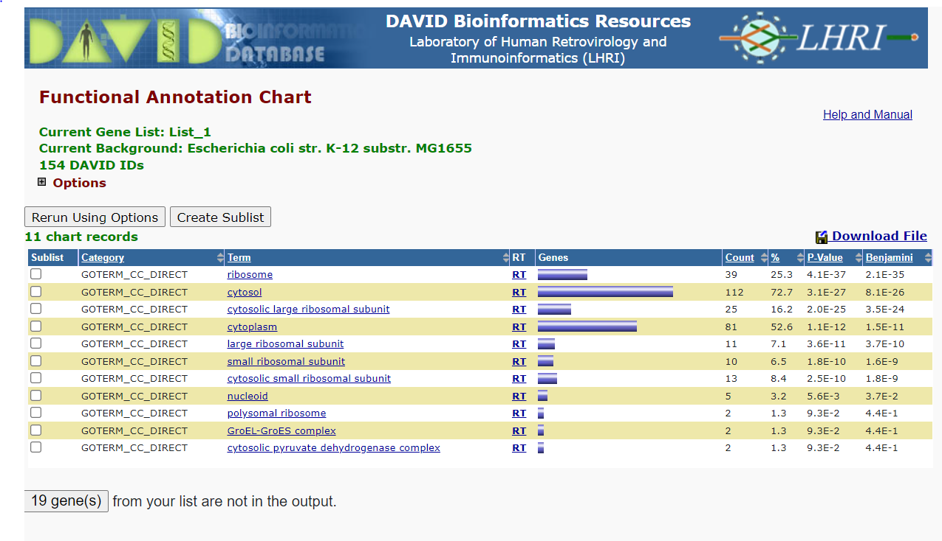

Slide 56
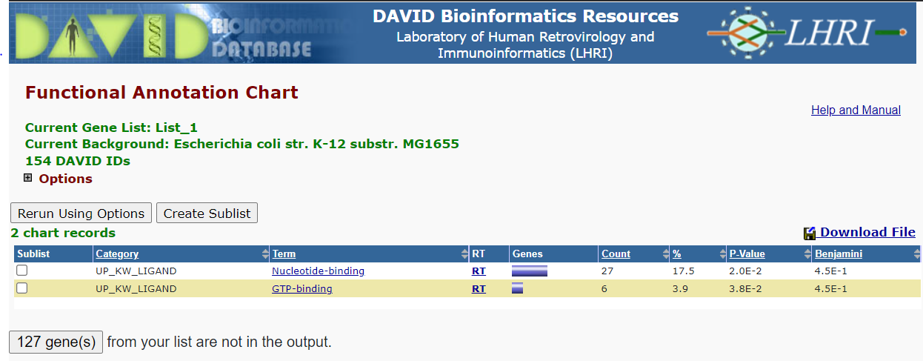

Slide 57


Slide 58


Slide 59


Slide 60


Slide 61


Slide 62

Third File(Yeast): DrosophilaMelanogaster_lcc_hq.txt
Visualization 1:
Between nodes and their Degrees

Slide 63
Visualization2:
Between Degree and Frequency

Slide 64
Visualization3:
Between K and P(k)

Slide 65

Visualization 4:
Between K and log P(k)

Slide 66
Hub proteins:
'P34082,E1JHT6,P18431,Q24322,P48462,Q24572,P05205,Q8I8V0,Q9VDD5,Q94517,Q24478,Q9VYX1,Q9VTZ1,Q45VV3,P07207,O76922,P16371,Q9VBX2,Q9V3J8,P20227,P26017,P91682,Q9V444,Q9VJ73,Q9W1K4,P25439,Q9NFU0,Q9W2I4,Q9W1I8,Q8T0S6,Q9VEC1,O18683,A0A0B4KHK1,Q9BI20,M9PHZ1,Q7KSD8,Q0KHR3,P29310,P18824,Q24306,Q9VLL1,Q8I8U9,P35820,P19339,P02299,Q9VKM1,P19538,P54623,P92177,P51123,Q24117,P15330,Q9XYU1,O96989,Q08605,P50536,Q9VHP9,Q9V4C8,P23128,Q9VI72,Q08473,Q08012,P48598,P21187,Q24368,P07663,O02193,P31007,P25158,P42124,Q9VF03,Q8IRY7,Q9VWF2,Q27272,Q9VM50,Q94527,Q7K148,P04412,Q24008,P43332,Q9VM59,Q24547,Q9VGW6,Q9VUQ5,Q24472,P62152,O97159,P42282,Q9VQB6,Q9VAP2'

Slide 67

DAVID Annotation Tool Annotation Summary Result

Slide 68


Slide 69


Slide 70


Slide 71


Slide 72


Slide 73


Slide 74


Slide 75


Slide 76


Slide 77


Slide 78


Slide 79


Slide 80


Slide 81


Slide 82


Slide 83


Slide 84


Slide 85


Slide 86


